Slide 1
Module 2

Slide 2
Electromagnetic Spectrum
When electrons move, they create electromagnetic waves that can propagate through space (even in a vacuum).
These waves were predicted by the British physicist James Clerk Maxwell in 1865 and first observed by the German physicist Heinrich Hertz in 1887.
The number of oscillations per second of a wave is called its frequency, f, and is measured in Hz (in honor of Heinrich Hertz).
The distance between two consecutive maxima (or minima) is called the wavelength, which is universally designated by the Greek letter λ (lambda).

Slide 3
When an antenna of the appropriate size is attached to an electrical circuit, the electromagnetic waves can be broadcast efficiently and received by a receiver some distance away. All wireless communication is based on this principle.
In a vacuum, all electromagnetic waves travel at the same speed, no matter what their frequency. This speed, usually called the speed of light, c, is approximately 3 × 108 m/sec, or about 1 foot (30 cm) per nanosecond.
The fundamental relation between f, λ, and c (in a vacuum) is
λf = c

Slide 4
Since c is a constant, if we know f, we can find λ, and vice versa. As a rule of thumb, when λ is in meters and f is in MHz, λf ∼∼ 300.
For example, 100-MHz waves are about 3 meters long, 1000-MHz waves are 0.3 meters long, and 0.1- meter waves have a frequency of 3000 MHz.

Slide 5
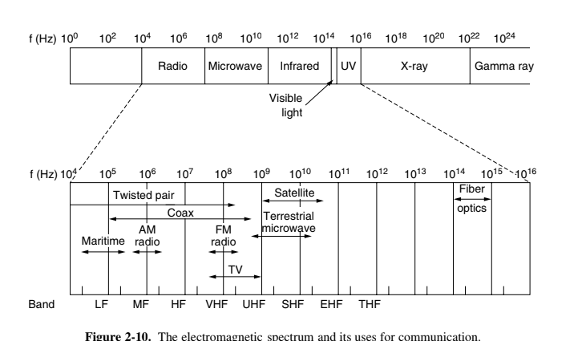

Slide 6
The electromagnetic spectrum is shown in Fig. 2-10. The radio, microwave, infrared, and visible light portions of the spectrum can all be used for transmitting information by modulating the amplitude, frequency, or phase of the waves.
Ultraviolet light, X-rays, and gamma rays would be even better, due to their higher frequencies, but they are hard to produce and modulate, do not propagate well through buildings, and are dangerous to living things.
The bands listed at the bottom of Fig. 2-10 are the official ITU (International Telecommunication Union) names and are based on the wavelengths, so the LF band goes from 1 km to 10 km (approximately 30 kHz to 300 kHz).
The terms LF, MF, and HF refer to Low, Medium, and High Frequency, respectively. Clearly, when the names were as signed nobody expected to go above 10 MHz, so the higher bands were later named the Very, Ultra, Super, Extremely, and Tremendously High Frequency bands.
Beyond that there are no names, but Incredibly, Astonishingly, and Prodigiously High Frequency (IHF, AHF, and PHF) would sound nice.

Slide 7
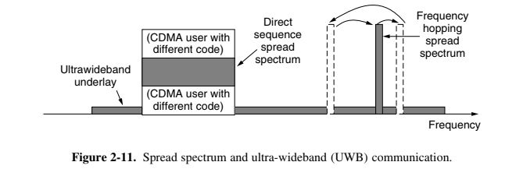

Slide 8
We know from Shannon that the amount of information that a signal such as an electromagnetic wave can carry depends on the received power and is proportional to its bandwidth.
From Fig. 2-10 it should now be obvious why networking people like fiber optics so much. Many GHz of bandwidth are available to tap for data transmission in the microwave band, and even more in fiber because it is further to the right in our logarithmic scale.
As an example, consider the 1.30-micron band of Fig. 2-7, which has a width of 0.17 microns. If we use Eq. (2-4) to find the start and end frequencies from the start and end wavelengths, we find the frequency range to be about 30,000 GHz. With a reasonable signal-to-noise ratio of 10 dB, this is 300 Tbps.

Slide 9
Most transmissions use a relatively narrow frequency band (i.e., Δf/f << 1). They concentrate their signals in this narrow band to use the spectrum efficiently and obtain reasonable data rates by transmitting with enough power. However, in some cases, a wider band is used, with three variations. In frequency hopping spread spectrum, the transmitter hops from frequency to frequency hundreds of times per second.
It is popular for military communication because it makes transmissions hard to detect and next to impossible to jam. It also offers good resistance to multipath fading and narrowband interference because the receiver will not be stuck on an impaired frequency for long enough to shut down communication.
This robustness makes it useful for crowded parts of the spectrum, such as the ISM bands we will describe shortly. This technique is used commercially, for example, in Bluetooth and older versions of 802.11.

Slide 10
A second form of spread spectrum, direct sequence spread spectrum, uses a code sequence to spread the data signal over a wider frequency band. It is widely used commercially as a spectrally efficient way to let multiple signals share the same frequency band. These signals can be given different codes, a method called CDMA (Code Division Multiple Access) that we will return to later in this chapter.
This method is shown in contrast with frequency hopping in Fig. 2-11. It forms the basis of 3G mobile phone networks and is also used in GPS (Global Positioning System). Even without different codes, direct sequence spread spectrum, like frequency hopping spread spectrum, can tolerate narrowband interference and multipath fading because only a fraction of the desired signal is lost.
It is used in this role in older 802.11b wireless LANs. For a fascinating and detailed history of spread spectrum communication, see Scholtz (1982).

Slide 11
A third method of communication with a wider band is UWB (Ultra- WideBand) communication. UWB sends a series of rapid pulses, varying their positions to communicate information.
The rapid transitions lead to a signal that is spread thinly over a very wide frequency band. UWB is defined as signals that have a bandwidth of at least 500 MHz or at least 20% of the center frequency of their frequency band.
UWB is also shown in Fig. 2-11. With this much bandwidth, UWB has the potential to communicate at high rates. Because it is spread across a wide band of frequencies, it can tolerate a substantial amount of relatively strong interference from other narrowband signals. Just as importantly, since UWB has very little energy at any given frequency when used for short-range transmission, it does not cause harmful interference to those other narrowband radio signals. It is said to underlay the other signals. This peaceful coexistence has led to its application in wireless PANs that run at up to 1 Gbps, although commercial success has been mixed. It can also be used for imaging through solid objects (ground, walls, and bodies) or as part of precise location systems.

Slide 12
Radio Transmission
Radio frequency (RF) waves are easy to generate, can travel long distances, and can penetrate buildings easily, so they are widely used for communication, both indoors and outdoors. Radio waves also are omnidirectional, meaning that they travel in all directions from the source, so the transmitter and receiver do not have to be carefully aligned physically.

Slide 13
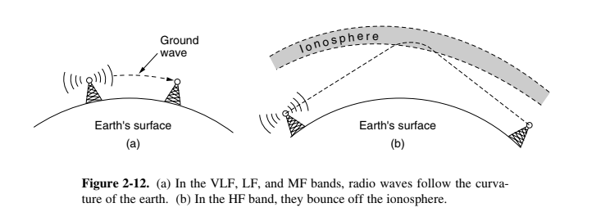

Slide 14
In the VLF, LF, and MF bands, radio waves follow the ground, as illustrated in Fig. 2-12(a). These waves can be detected for perhaps 1000 km at the lower frequencies, less at the higher ones. AM radio broadcasting uses the MF band,which is why the ground waves from Boston AM radio stations cannot be heard easily in New York. Radio waves in these bands pass through buildings easily,which is why portable radios work indoors. The main problem with using these bands for data communication is their low bandwidth.

Slide 15
In the HF and VHF bands, the ground waves tend to be absorbed by the earth.
However, the waves that reach the ionosphere, a layer of charged particles circling the earth at a height of 100 to 500 km, are refracted by it and sent back to earth, as shown in Fig. 2-12(b). Under certain atmospheric conditions, the signals can bounce several times. Amateur radio operators (hams) use these bands to talk long distance. The military also communicate in the HF and VHF bands.

Slide 16
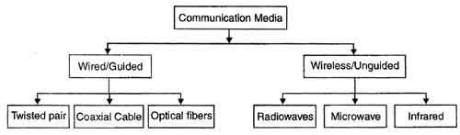
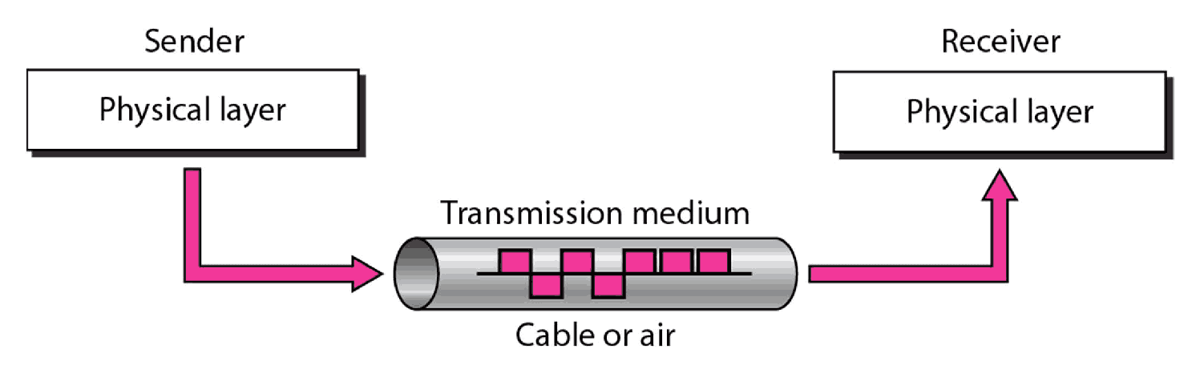
2.1 Introduction to Physical Media
The purpose of the physical layer is to transport bits from one machine to another.
Various media can be used for the actual transmission.
Media are roughly grouped into guided media and unguided media
Guided media :: waves are guided along a physical path (e.g, twisted pair, coaxial cable and optical fiber).
Unguided media:: means for transmitting but not guiding electromagnetic waves (e.g., the atmosphere and outer space).

Slide 17

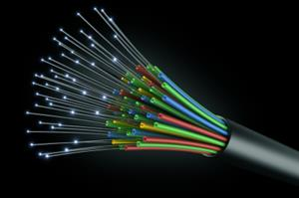
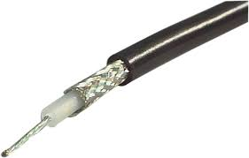
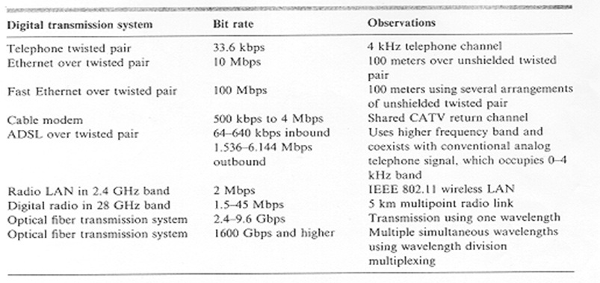
Guided or wired Media
Magnetic media
Twisted pair
Coaxial cable
Optical fiber
Wireless communications
Table showing bits rates
of Digital transmission
System

Slide 18
Magnetic Media
Most common ways to transport data is to write them on magnetic tapes (recordable DVDs), transport them to destination machine and read them back.
It is cost effective, especially for applications where high bandwidth or cost per bit is the key factor.
An industry standard Ultrium tape can hold 800 GB. A thousand of these have capacity of 800 TBytes. The effective bandwidth of this transmission is 70 Gbps.
At $40 per tape, which can be used at least 10 times. The cost for this transmission is approximately $4,000 per useage.

Slide 19
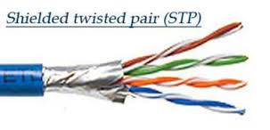
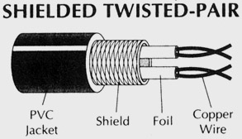
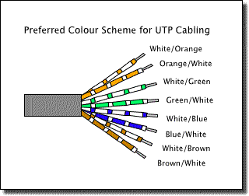
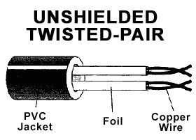
1. Twisted Pair
Two insulated wires arranged in a spiral pattern
Copper or steel coated with copper
The signal is transmitted through one wire and a ground reference is transmitted in the other wire.
Typically twisted pair is installed in building telephone wiring.
Local loop connection to central telephone exchange is twisted pair.
Limited in distance, bandwidth and data rate due to problems with attenuation, interference and noise
Issue: cross-talk due to interference from other signals
“shielding” wire (shielded twisted pair (STP)) with metallic braid or sheathing reduces interference.
“twisting” reduces low-frequency interference and crosstalk.

Slide 20
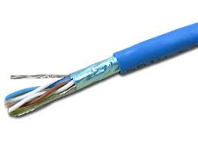
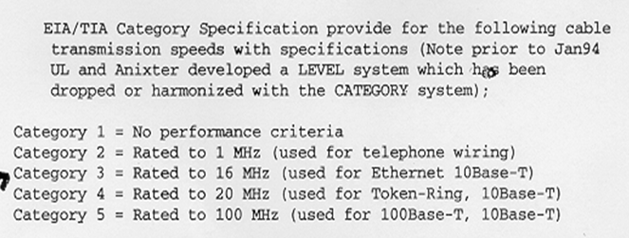
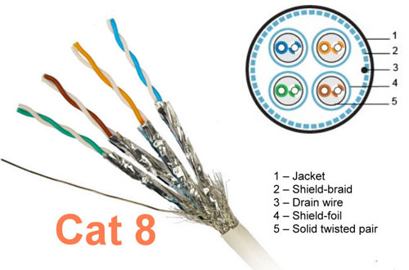
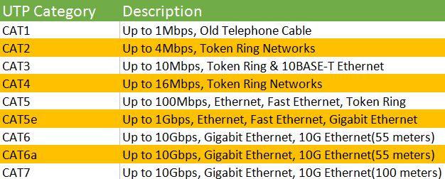
Unshielded Twisted Pair

Slide 21
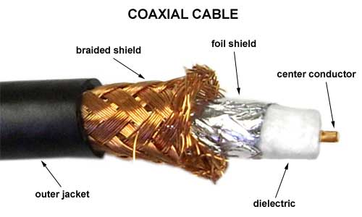
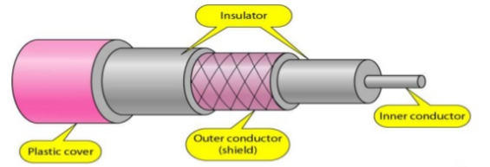
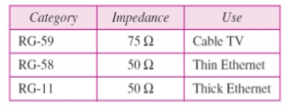
2. Coaxial Cable
for coax used in LANs thee are two basic categories :
50-ohm cable [baseband]
75-ohm cable [broadband or single channel baseband]
Coax has better noise immunity for higher frequencies than twisted pair.
Coaxial cable provides much higher bandwidth than twisted pair.
Cable is ‘bulky’.

Slide 22
Baseband Coax
50-ohm cable is used exclusively for digital transmissions
Uses Manchester encoding, geographical limit is a few kilometers.
10Base5 Thick Ethernet :: thick (10 mm) coax
10 Mbps, 500 m. max segment length, 100 devices/segment, awkward to handle and install.
10Base2 Thin Ethernet :: thin (5 mm) coax
10 Mbps, 185 m. max segment length, 30 devices/segment, easier to handle, uses T-shaped connectors.
Broadband Coax
75-ohm cable (CATV system standard)
Used for both analog and digital signaling.
Analog signaling – frequencies up to 500 MHZ are possible.
When FDM used, referred to as broadband.
For long-distance transmission of analog signals, amplifiers are needed every few Kms.

Slide 23
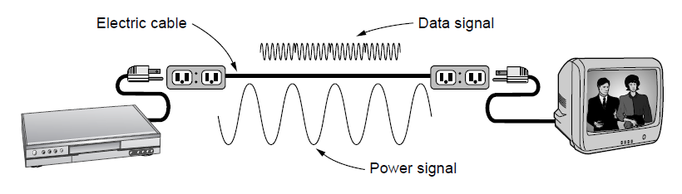
Power Lines
Power lines deliver electrical power to houses and wiring distributes it to power outlets
Used for low rate communication like remote metering
Recently used for LAN and broadband
Data signal is superimposed on low frequency power signal through the same electrical wiring
Issues:
Wiring varies from house to house
Attenuation of wires is in hertz whereas needed for data signals is MHz
Electrical wires pick up external signals; thus susceptible to noise

Slide 24
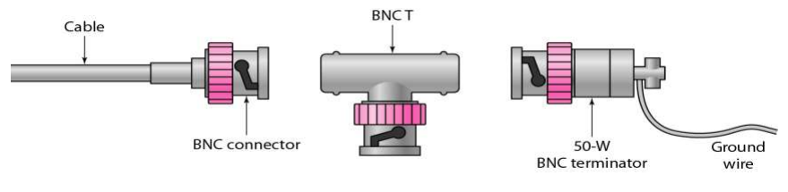
Connectors
To connect coaxial cable to devices, it is necessary to use coaxial connectors. The most common type of connector is the Bayone-Neill Concelman, or BNC, connectors. BNC connectors are sometimes referred to as bayonet mount, as they can be easily twisted on or off. There are three types: the BNC connector, the BNC T connector, the BNC terminator
Coaxial cable applications include analog and digital telephone networks, cable TV networks, Ethernet LANs and short range connections.

Slide 25
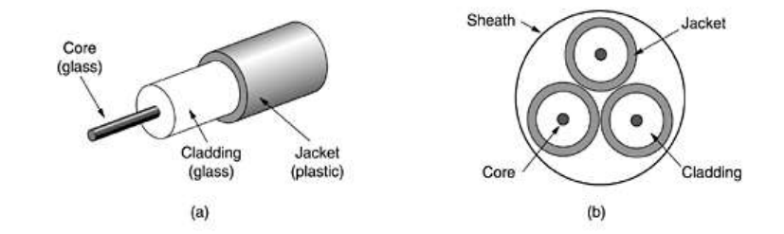
3. Optical fiber
Fiber-optic cable or optical fiber consists of thin glass fibers that can carry information in the form of visible light. The typical optical fiber consists of a very narrow strand of glass or plastic called the core.
Around the core is a concentric layer of less dense glass or plastic called the cladding, whose refractive index is less than that of the core. The outer most layer of the cable is known as the jacket, which shields the cladding and the core from moisture, crushing and abrasion.
Three standard wavelengths : 850 nanometers (nm.), 1300 nm, 1500 nm.
First-generation optical fiber :: 850 nm, 10’s Mbps using LED (light-emitting diode) sources.
Second and third generation optical fiber :: 1300 and 1500 nm using ILD (injection laser diode) sources, gigabits/sec.

Slide 26
Optical fiber
Optical fiber :: a thin flexible medium capable of conducting optical rays. Optical fiber consists of a very fine cylinder of glass (core) surrounded by concentric layers of glass (cladding).
a signal-encoded beam of light (a fluctuating beam) is transmitted by total internal reflection.
Total internal reflection occurs in the core because it has a higher optical density (index of refraction) than the cladding.
Attenuation in the fiber can be kept low by controlling the impurities in the glass.
Lowest signal losses are for ultrapure fused silica – but this is hard to manufacture.
Attenuation loss is lower at higher wavelengths.
There are two types of detectors used at the receiving end to convert light into electrical energy (photo diodes):
PIN detectors – less expensive, less sensitive
APD detectors
ASK is commonly used to transmit digital data over optical fiber {referred to as intensity modulation}.

Slide 27
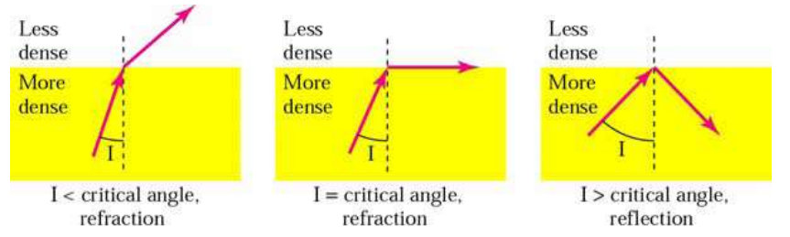
Light Propagation
Optical fibers transmit a beam of light by means of total internal reflection. When a light beam from a source enters the core, the core refracts the light and guides the light along its path. The cladding reflects the light back into the core and prevents it from escaping through the medium.

Slide 28
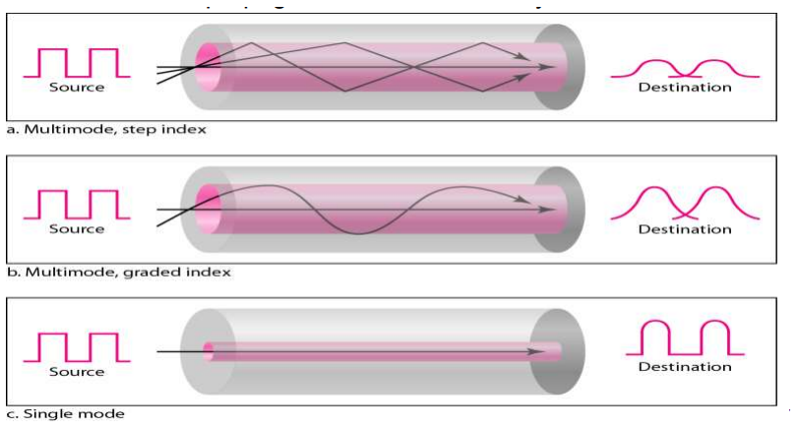
Modes of Propagation
Fiber optic cables support two modes of propagating light, which are multimode and single mode. In multimode, many beams from a light source traverse along multiple paths and at multiple angles. In single mode, the beams propagate almost horizontally.

Slide 29
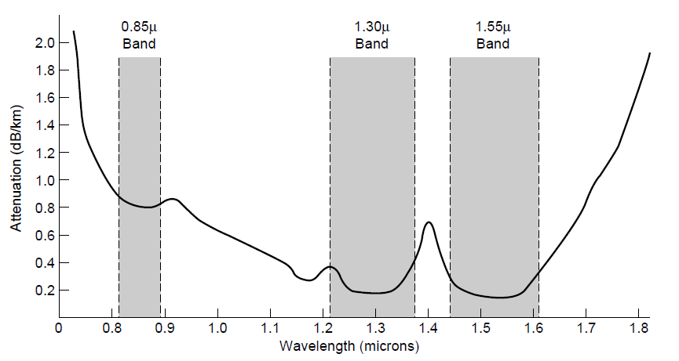
Transmission of Light Through Fiber
Figure shows attenuation in units of decibels per linear kilometer of fiber Vs Wavelength in microns.
Three wavelength bands are most commonly used at present for optical communication.
They are centered at 0.85, 1.30 and 1.55microns, all three bands are 25000 to 30000 GHz wide.
The 0.85micron band was used first, has higher attenuation and so is used for shorter distances but at what wavelength the lasers and electronics could be made from the same material (gallium arsenide)
The last two bands have good attenuation properties (less than 5% loss per kilometer)
The 1.55-micron band is now widely used with erbium-doped amplifiers that work directly in the optical domain.
Attenuation of light through fiber in the infrared region

Slide 30
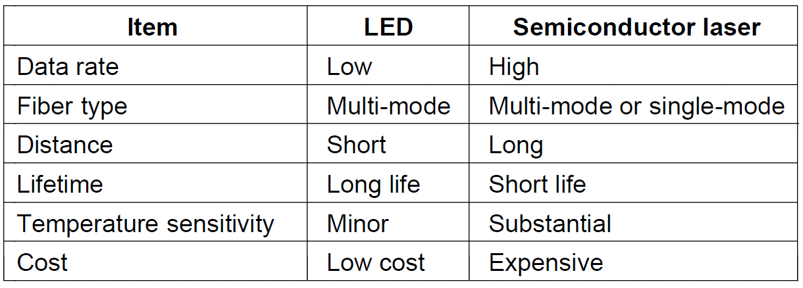
Fiber Cables
A comparison of semiconductor diodes and LEDs as light sources

Slide 31
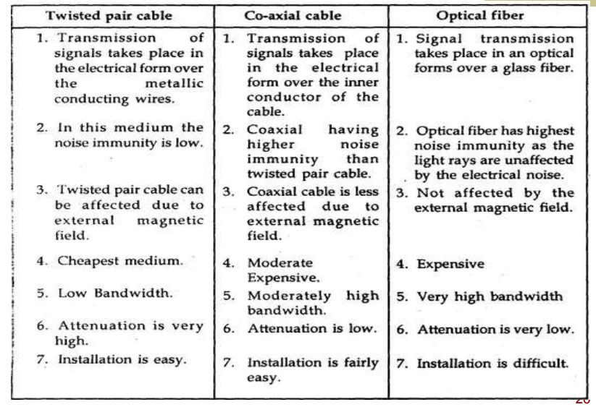
Comparison of Twisted Pair, Coaxial and optical Fiber

